Slide 1
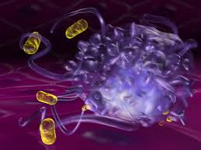
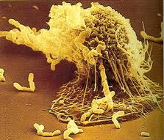
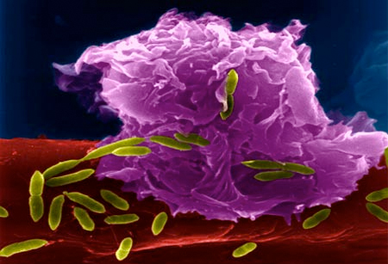
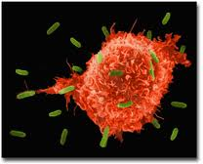
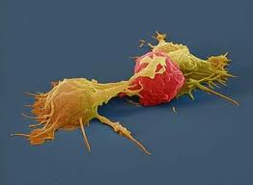
  Infectious Diseases
  Lesson 5.1

Slide 2
Where are we heading…..
Unit 1: What is an infectious disease and why do we care?
Unit 2: What does it mean to have an infectious disease?
Unit 3: When does a microbe become pathogenic?
Unit 4: How do pathogens make us sick?
Unit 5: How do we get better?

Slide 3
Lesson Objectives:
After finishing today’s lesson, you will be able to:
describe innate immune structures and their functions.
explain how innate immune cells recognize a pathogen.
explain how the innate cells respond to a pathogen.

Slide 4
Do Now
Use the next 3 minutes to list as many immune structures and functions as you can!
  Physical
  Chemical
  Cellular

Slide 5
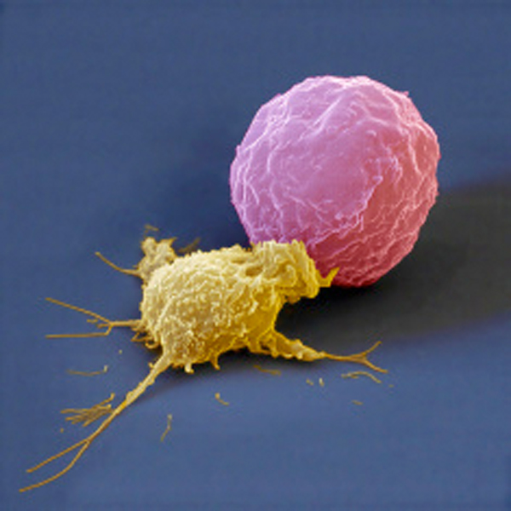
Review of immune structures and cells
Physical
Chemical
Cellular
Cancer cell
Neutrophil
A neutrophil (in yellow)
ingesting a cancer cell (in pink).

Slide 6
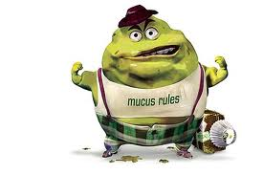
Physical
Skin
Hair
Mucus
Tears
How do these barriers work?

Slide 7
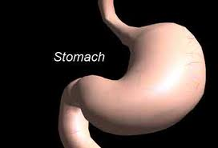
Chemical
Defensins
Complement
Stomach acid
How do these barriers work?

Slide 8
Cellular
  Innate cells:
    Macrophages
    Dendritic cells
    Neutrophils
  Adaptive cells:
    B cells
    T cells
Cancer cell
Neutrophil
Where are immune cells made?

Slide 9
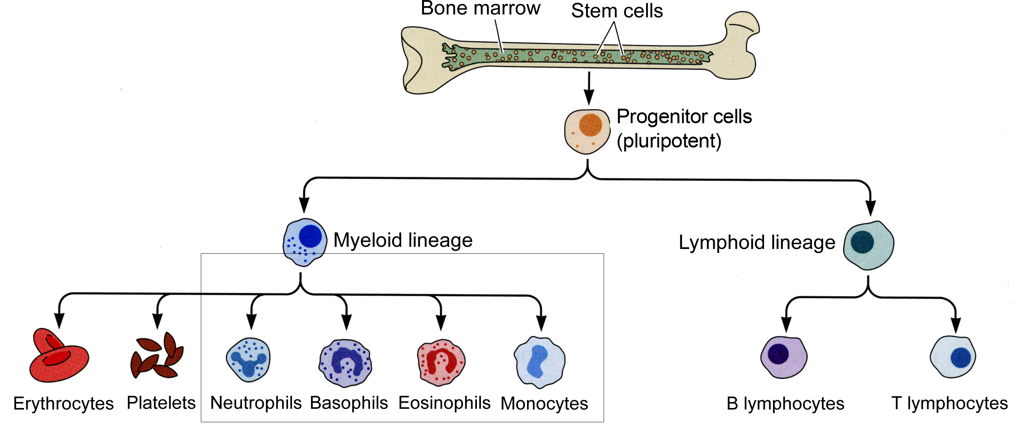
All immune cells are made in the bone marrow
They all come from a parent cell (stem cell).
Innate cells
Adaptive cells

Slide 10
Discussion
What is innate immunity?
  Non-specific mechanisms of immune defense we are born with. It does not change!
  What is the function of innate cells?
    To patrol the body looking for invaders to inactivate.

Slide 11
Innate cells patrol the body using receptors on their surface that allow them to identify invaders and inactivate them.
Neutrophil
Macrophage

Slide 12
How do innate cells recognize invaders/pathogens?

Slide 13
Invaders have PAMPs
Innate immune receptors ‘see’ foreign molecules called PAMPs (Pathogen- Associated Molecular Patterns).
Can you think of examples for bacterial and viral PAMPs? Write them down in your worksheet.

Slide 14
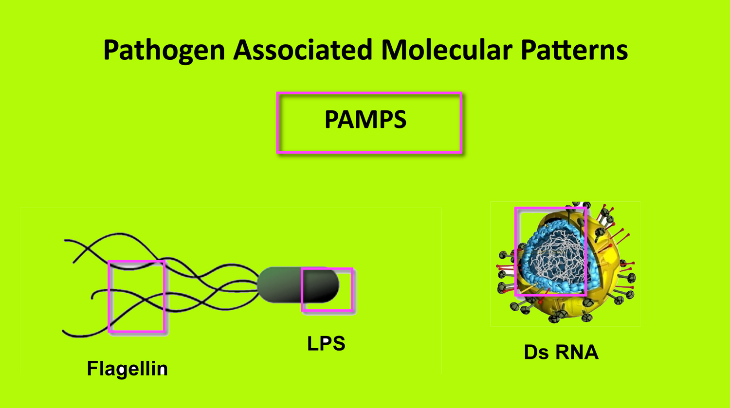
PAMPs (Pathogen-Associated Molecular Patterns)
Innate immune receptors ‘see’ foreign molecules called PAMPs.
PAMPs may be:
  - Bacteria or fungal cell wall parts like LPS
  - Flagellin (flagellum protein)
  - Viral dsRNA
  - Viral proteins
Do you think PAMP patterns will be found in host cells?

Slide 15
Once innate cells recognize the invaders, how do they fight them?

Slide 16
Innate cells respond to invaders in three ways:
One - Phagocytosis: eating the invader
Two - Chemotaxis: recruiting help
Three - Activate the adaptive immune system
Neutrophil
Macrophage

Slide 17
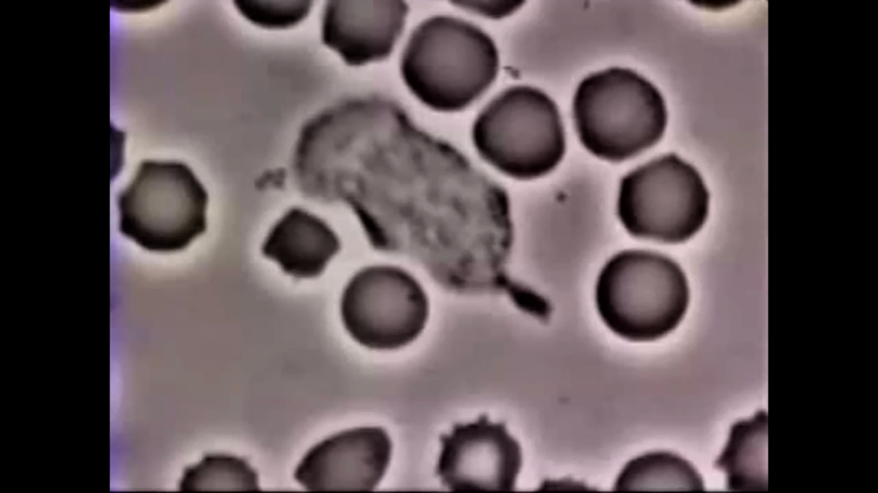
One – Phagocytosis eating
the invader

Slide 18
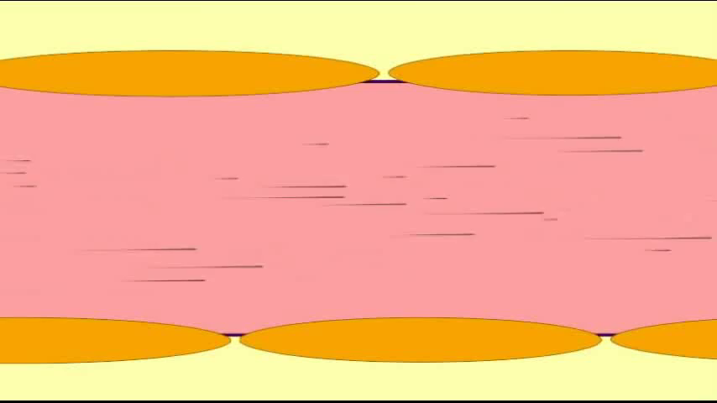
Two - Chemotaxis: recruiting help

Slide 19
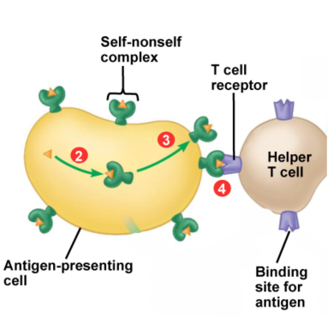
Three - Innate cells activate
adaptive cells
After digesting the pathogen some innate cells stick its parts (antigens) on their cell membrane:
  These cell are now called Antigen Presenting Cells (APCs)
By presenting the antigens on their surface they can activate T cells (types of adaptive immune cells).

Slide 20
Wrap Up
    Physical and chemical barriers are part of the innate immune system on the outside of the body.
    Innate cells are in the sterile interior.
    Innate cells have receptors that see pathogen associated patterns (PAMPs) not found in the host (non-self vs. self).
    After recognizing a PAMP, innate cells phagocytize the invader and present its antigens on their surface.
    Then they secrete chemokines to call for help from more innate cells.
    Innate receptors cannot adapt to mutating PAMPs, so they may also call for help from the adaptive immune system.

Slide 21
Homework
You will be handed cards of the immune system and two pathogens. DO NOT LOSE THEM!
After every lesson in Unit 5 review the cards and cut the ones that were discussed in class that day.
Make sure you understand everything they say. If you have any questions, please ask your teacher. You will need to have all the cards ready for Lesson 5.4.

